Slide 1

ML Hackathon – Oct 24
Submitted by
Rajkumar Rajendran
Github:- https://github.com/rrajkumarinfo/machinehackthon-predict-sale-Shiv-Nadar-University.git

Slide 2
Agenda
Overview
Descriptive Analytics
Observations
Exploratory Data Analysis(EDA)
Feature Engineering
Data Preparation
Modeling
Results & Submission
Parameter tuning

Slide 3
Overview
About Data Set:
The sales in the mega marts are critical to make them sustainable. As a matter of fact, the rise of several marts have created buyers of different categories which are critical about quality of product at the right price.
In the Data Analytics Championship 2021, the data science & machine learning community has been challenged to build an ML model and predict the sales of each product from each outlet. The participants also need to use the model to analyse the properties of the product in the stores and find ways to increase sales.
Data attributes:
Item_ID: Item Identification Number
Item_W: Item Weight
Item_Type: Item
Item_MRP: MRP of the Product
Outlet_ID: Outlet ID
Outlet_Year: Outlet Establishment year
Outlet_Size: Size of the outlet
Outlet_Type: Type of the outlet
Sales: Total sales from the outlet
Train: 87864 rows x 09 columns
Test: 37656 rows x 09 columns

Slide 4
Descriptive Analytics

Slide 5
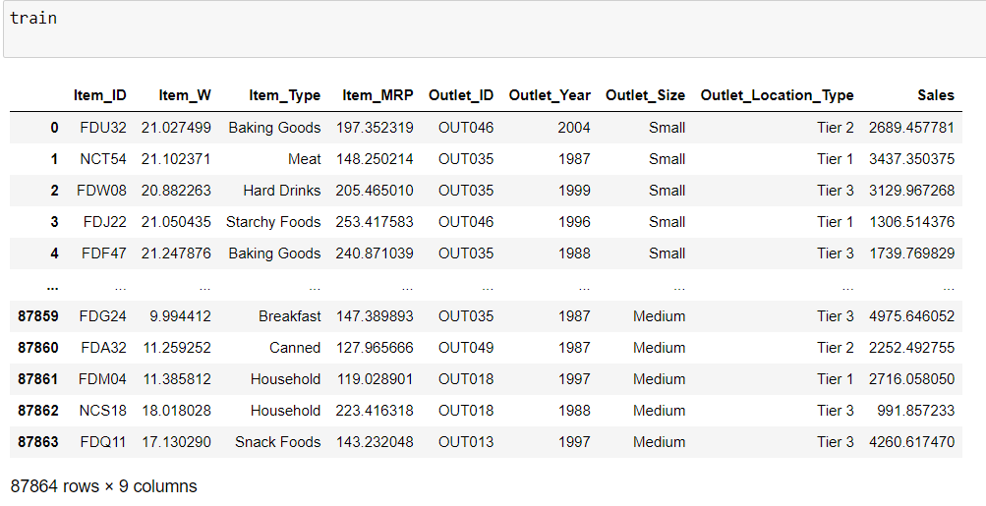
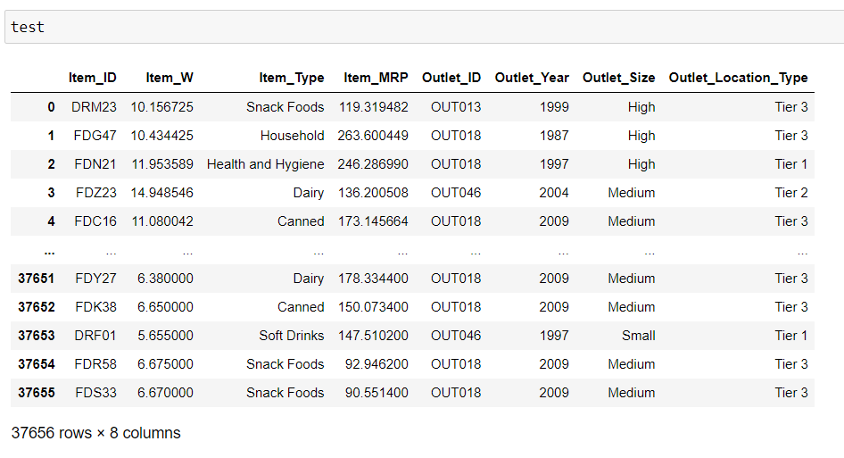
Train and Test Data - Analysis

Slide 6

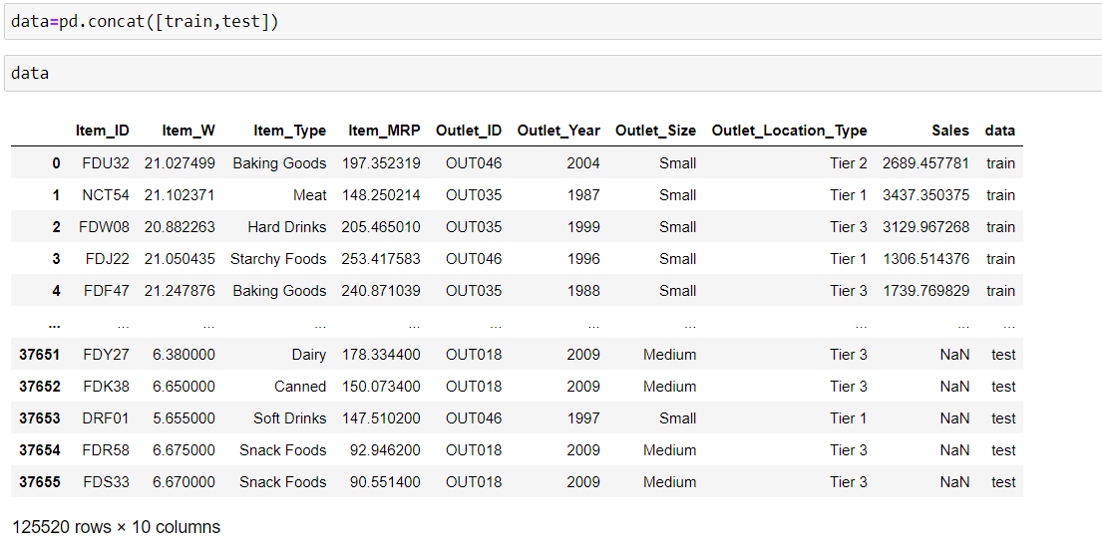
Concatenate Train and Test

Slide 7
Observations
1. No null value <br>
2. No Duplicate value <br>
3. Check the sales of each item based on Item_Weight <br>
4. Check the sales of each item based on Item_Type <br>
5. Check the sales of each item based on Item_MRP <br>
6. Three types of Outlet id available.Check the sales of each Outlet based on Outlet id <br>
7. Three types of Outlet_Size available.Check the sales of each Outlet based on Outlet_Size <br>
8. Three types of location available. Check the sales of each Tier <br>

Slide 8
Exploratory Data Analysis(EDA)

Slide 9
Exploratory Data Analysis(EDA)
The Steps In Exploratory Data Analysis (EDA):
Description of data
Handling missing data
Understanding relationships and new insights through plots

Slide 10
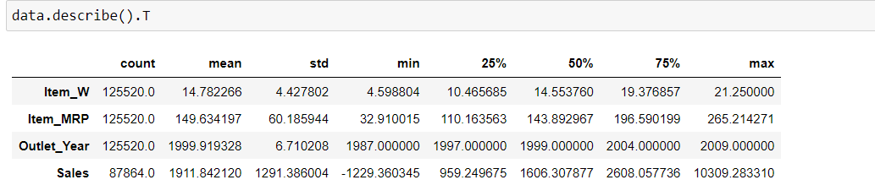
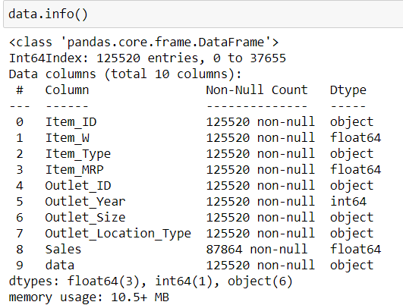
EDA- Description of data

Slide 11
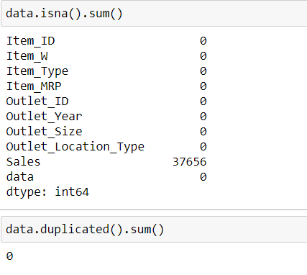
EDA- Handling missing data
Sales – 37656 are test data. No sales values available.
No other missing data available

Slide 12
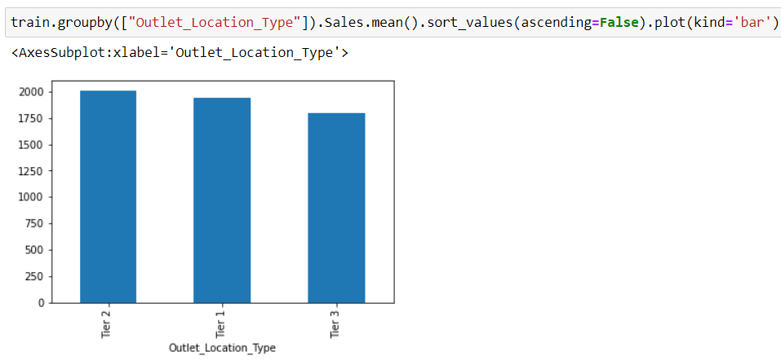
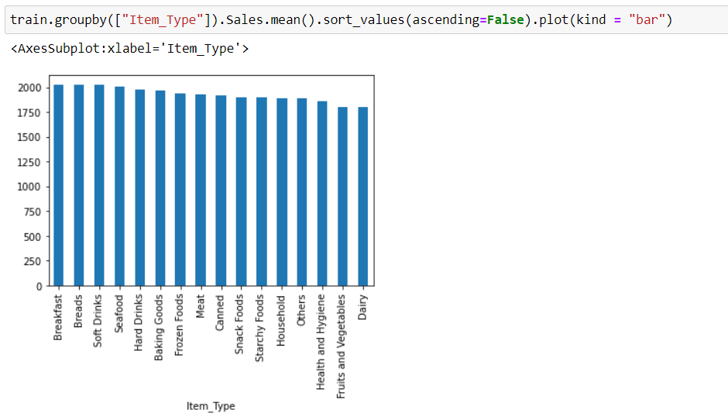
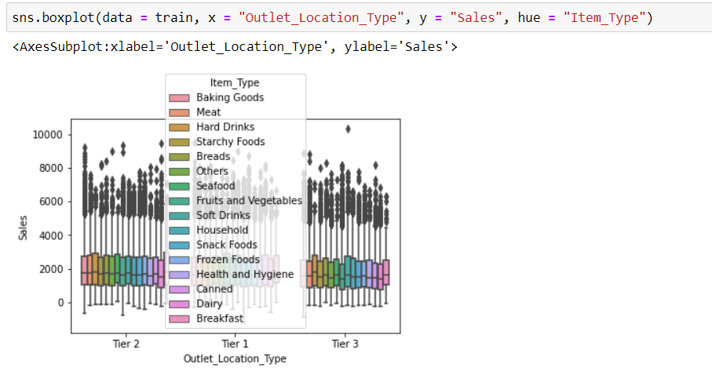
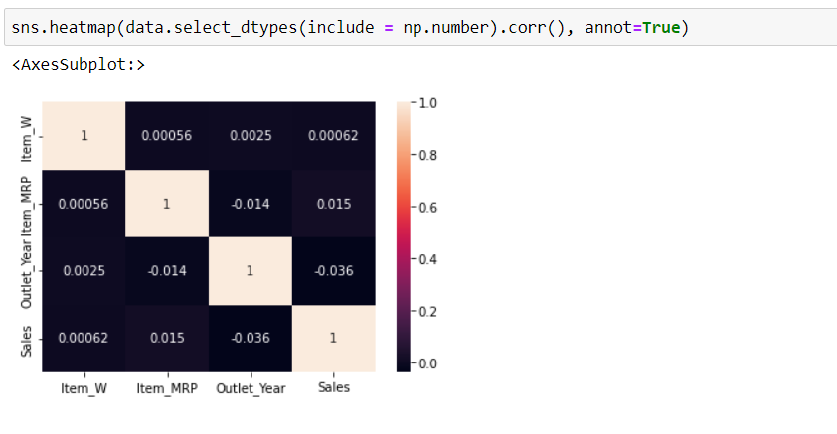
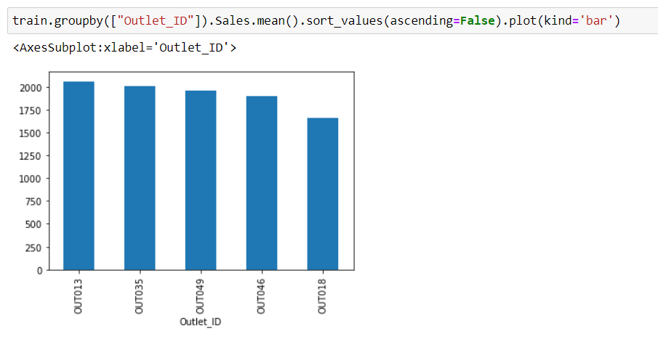
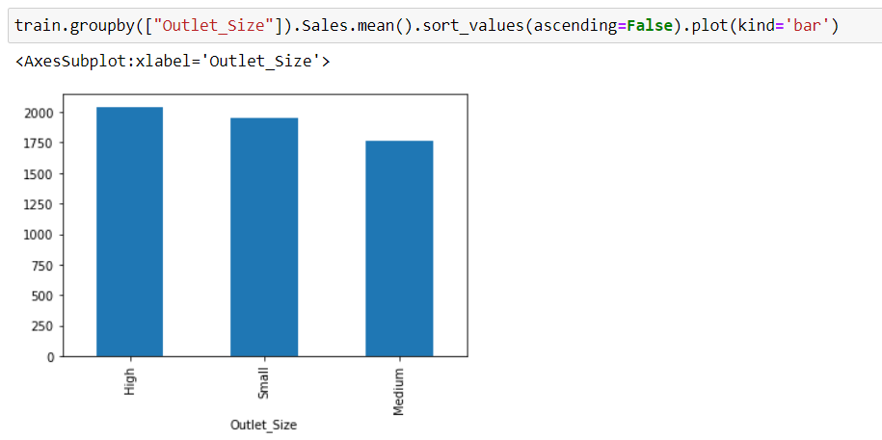
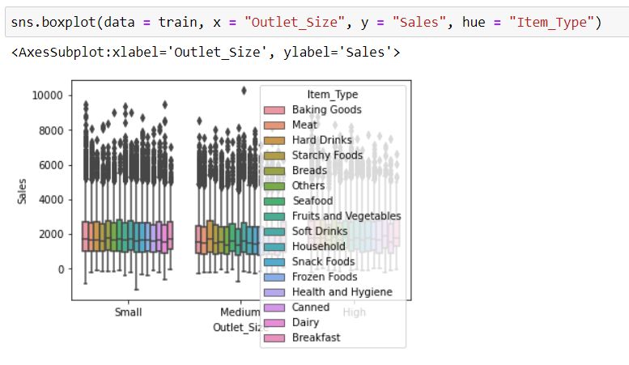
EDA- Understanding relationships through plots

Slide 13
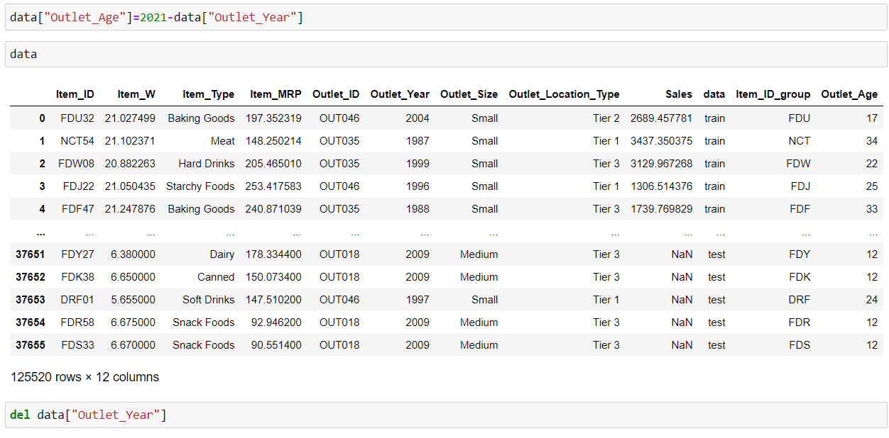
Feature Engineering

Slide 14
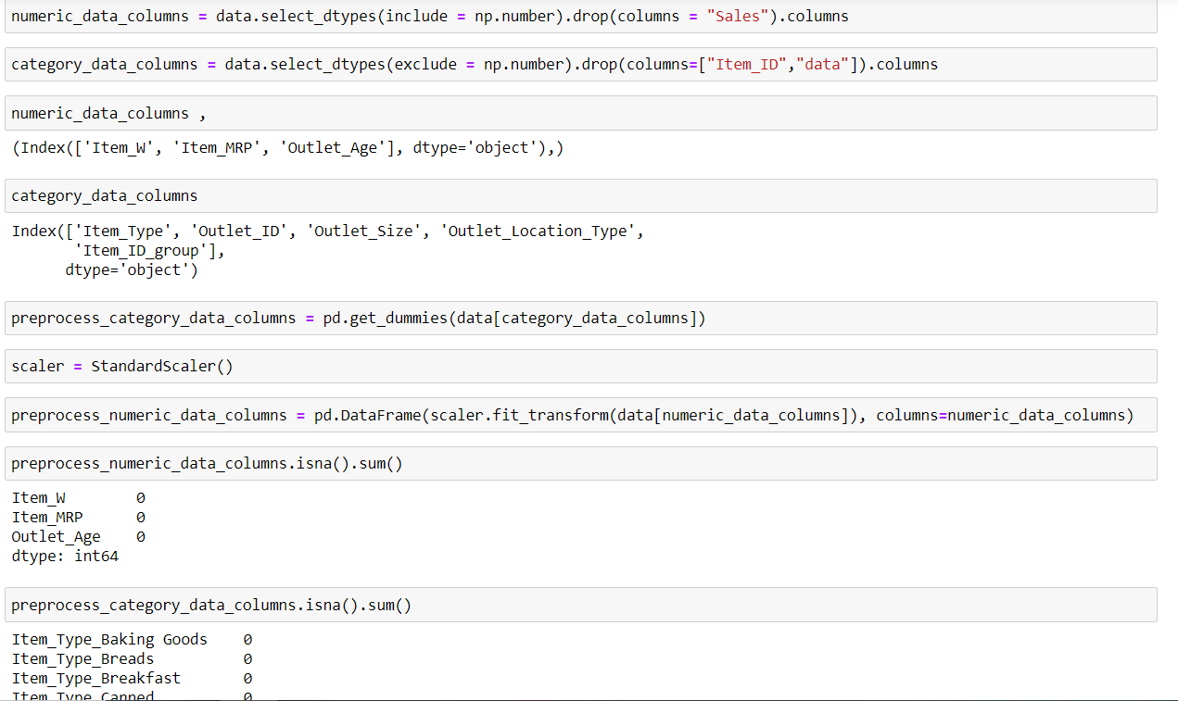
Data Preparation

Slide 15
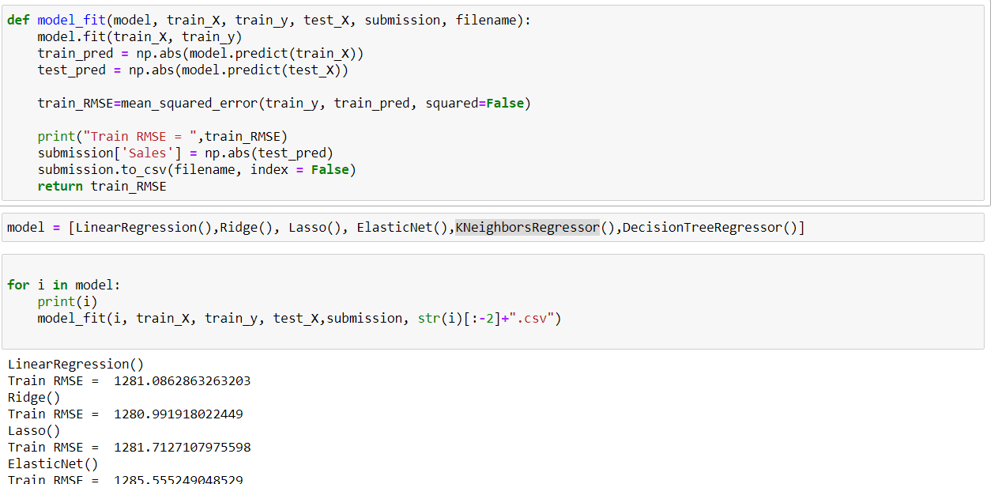
Modeling

Slide 16
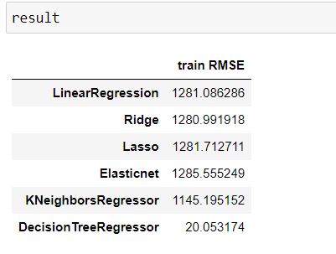
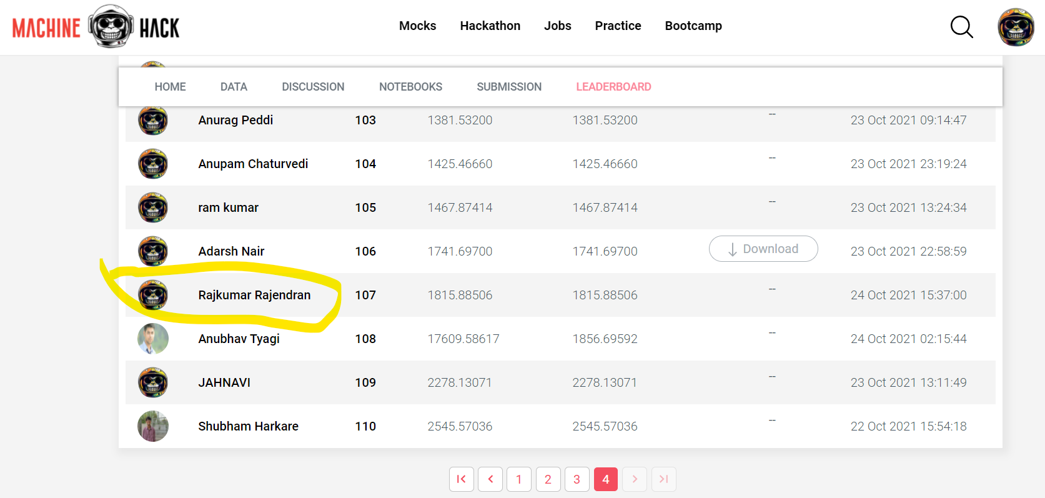
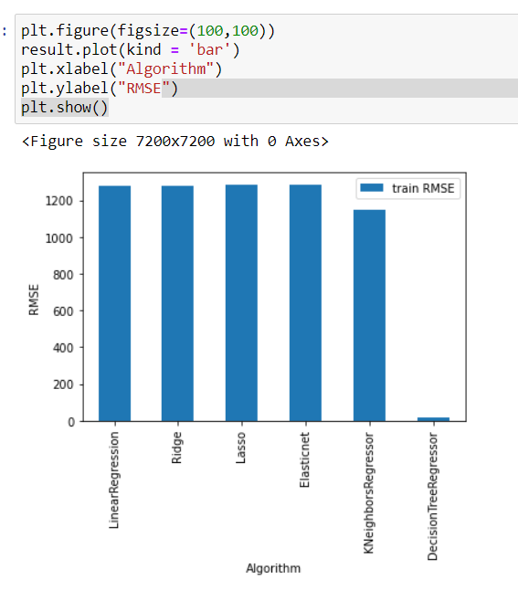
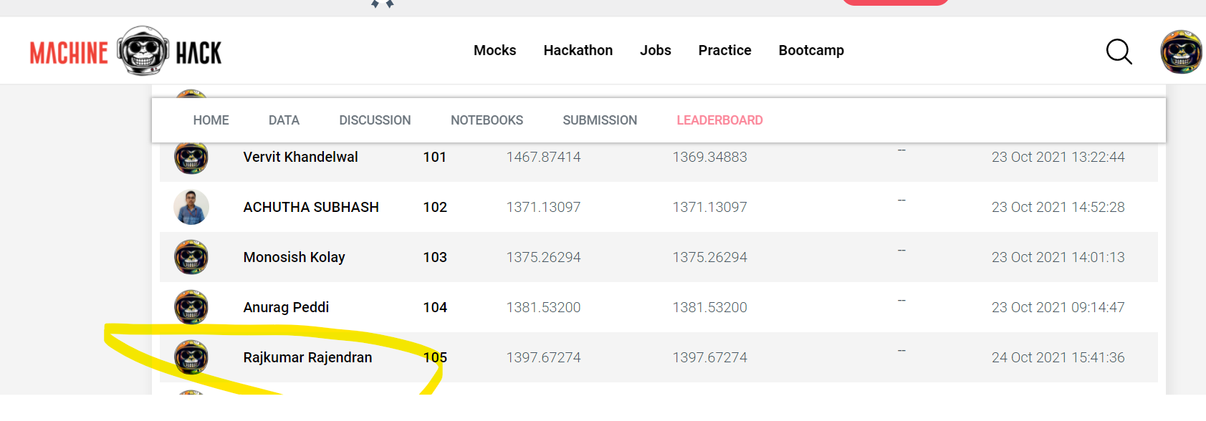
Results & Submission Score
Discission Tree Regressor : RMSE =20.053174 and Score =1815.88506 & Rank=107
KNeighborsRegressor: RMSE =1145.195152 and Score =1397.672746 & Rank=105

Slide 17
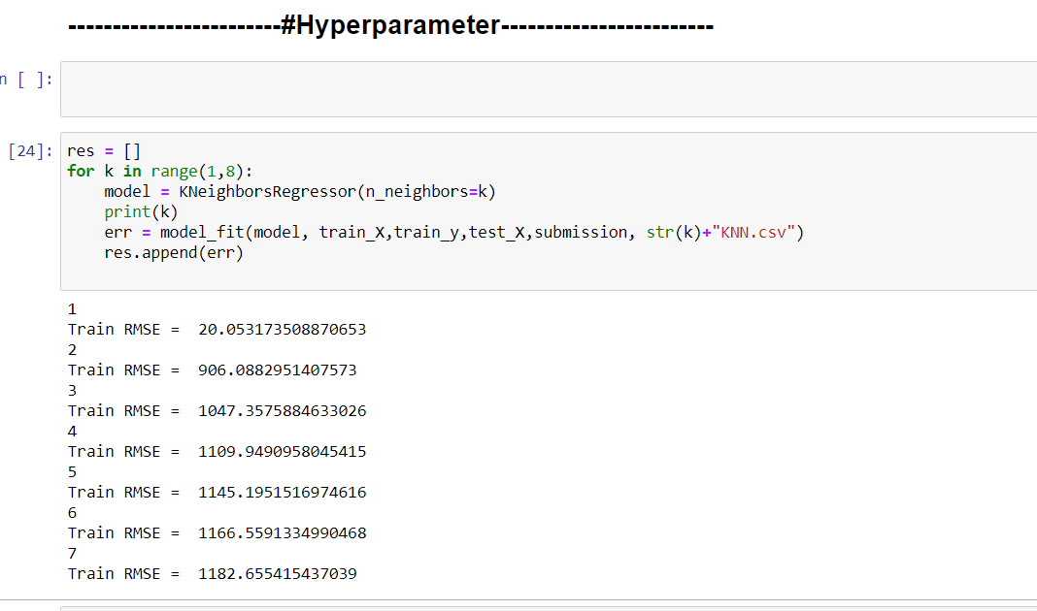
Parameter tuning

